Slide 1

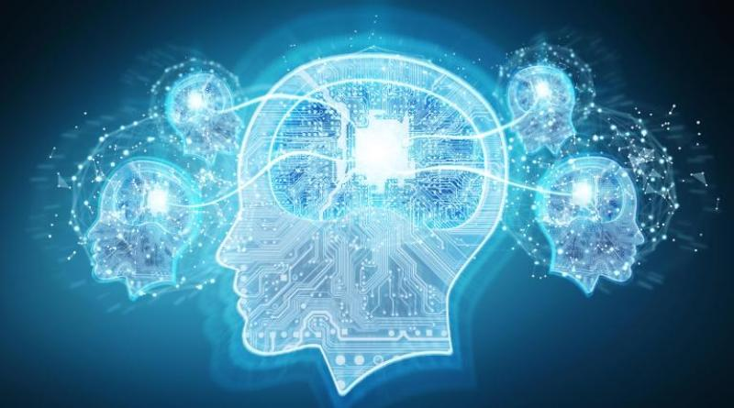
DEEP DIVE INTO DEEP LEARNING
PRESENTED BY:
INDERPREET SINGH
RASHANDEEP SINGH
UNDER GUIDANCE OF :
DR. SUNIL K SINGH
SUDHAKAR KUMAR

Slide 2
AGENDA
Artificial Intelligence
Machine Learning
Deep Learning
Applications of Deep Learning
Deep Learning Algorithms
Artificial Neural Network (ANN)
Problem Statement
Practical Implementation

Slide 3
Artificial Intelligence
According to the father of Artificial Intelligence, John McCarthy, it is “The science and engineering of making intelligent machines, especially intelligent computer programs”.
Artificial intelligence is the simulation of human intelligence processes by machines, especially computer systems. Specific applications of AI include expert systems, natural language processing, speech recognition and computer vision.

Slide 4
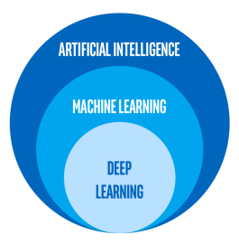
Artificial Intelligence is a broader umbrella under which Machine Learning (ML) and Deep Learning (DL) comes. Diagram shows, ML is subset of AI and DL is subset of ML

Slide 5
Deep Learning
Deep learning is a collection of statistical techniques of machine learning for learning feature hierarchies that are actually based on artificial neural networks.
A few years ago, we would’ve never imagined deep learning applications to bring us self driving cars and virtual assistants like Alexa, Siri and Google Assistant. But today, these creations are part of our everyday life. Deep Learning continues to fascinate us with its endless possibilities such as fraud detection and pixel restoration.

Slide 6
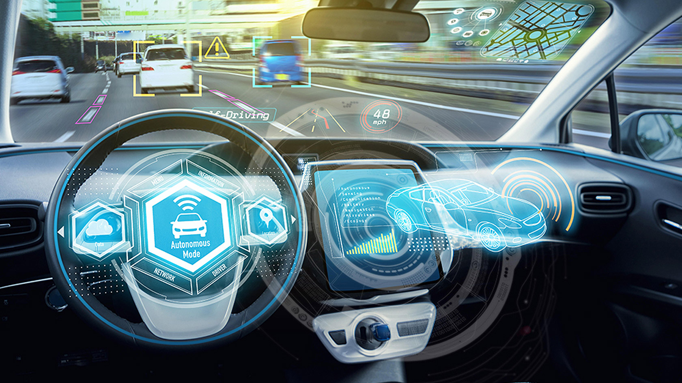
SELF-DRIVING CARS

Slide 7
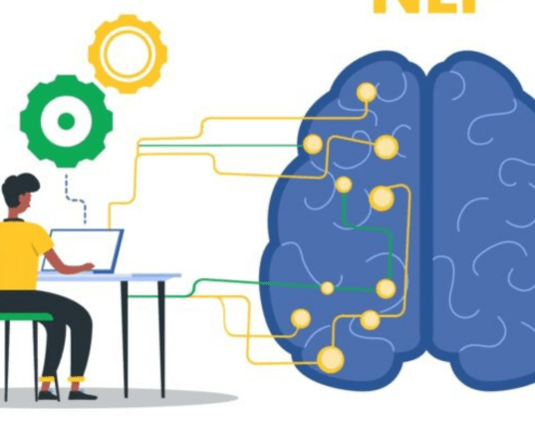
NATURAL LANGUAGE PROCESSING

Slide 8
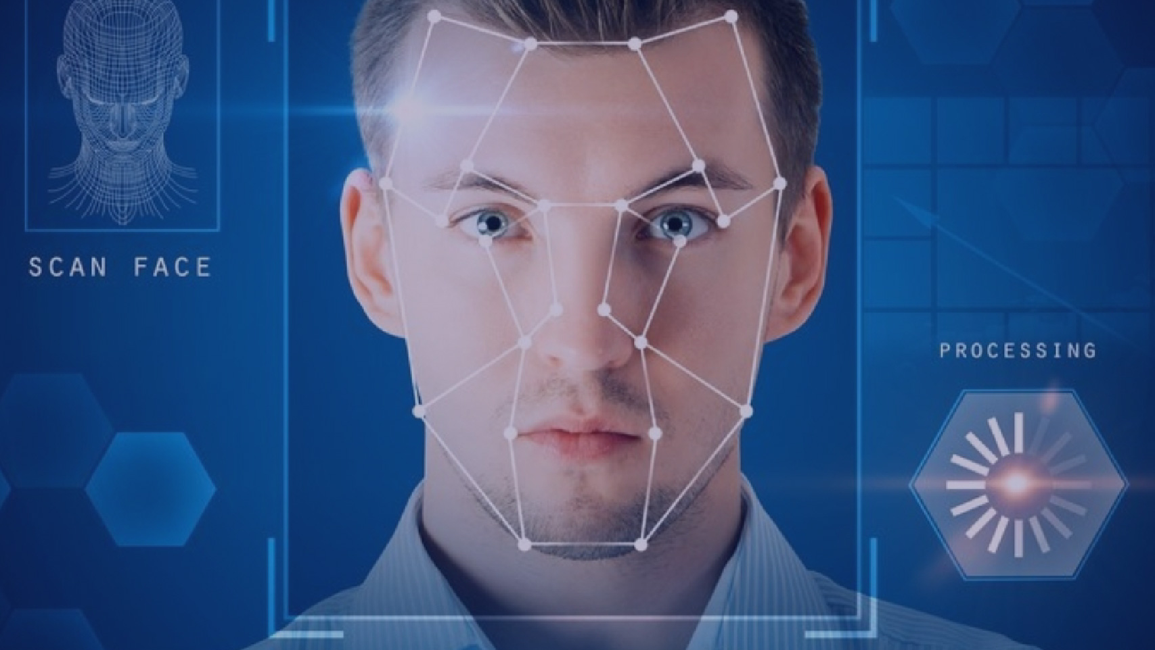
VISUAL DETECTION

Slide 9

FRAUD DETECTION

Slide 10
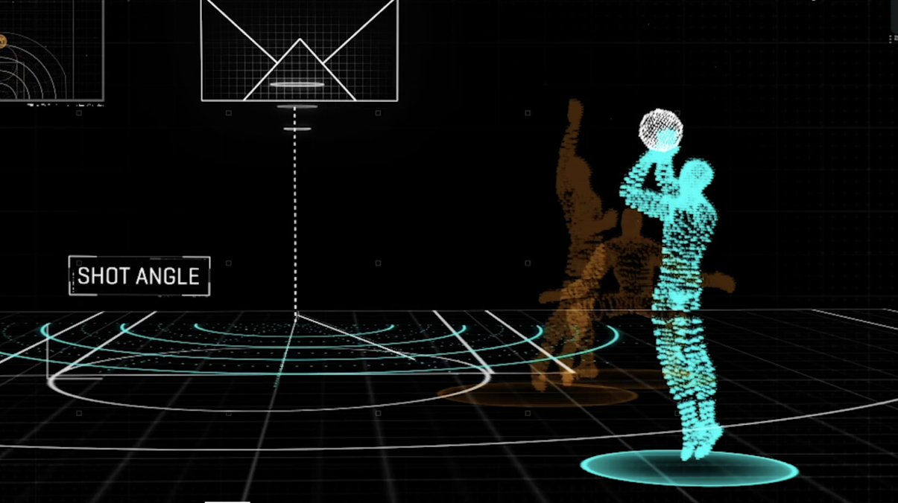
ENTERTAINMENT

Slide 11
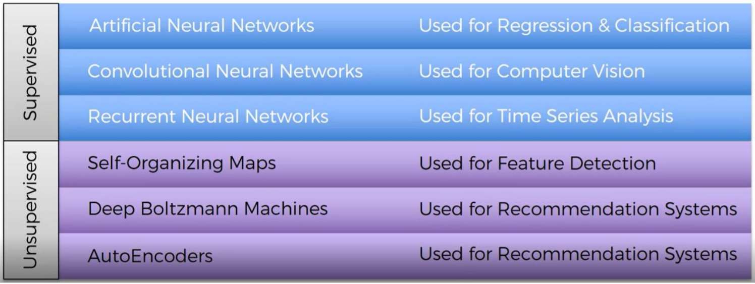
DEEP LEARNING ALGORITHMS

Slide 12
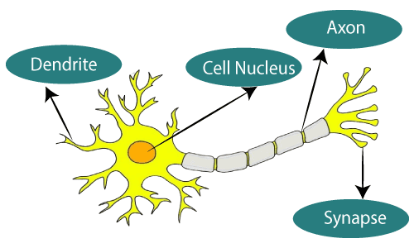
ANN
Neural networks sometimes called as Artificial Neural networks(ANN’s), because they are not natural like neurons in your brain. They artificially mimic the nature and functioning of Neural network
The term "Artificial neural network" refers to a biologically inspired sub-field of artificial intelligence modeled after the brain.
An Artificial neural network is usually a computational network based on biological neural networks that construct the structure of the human brain.

Slide 13
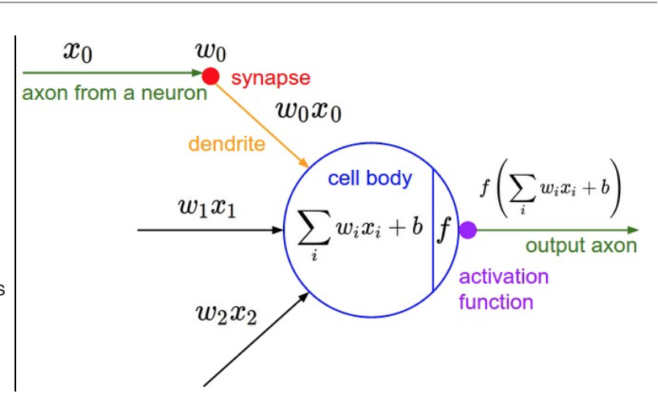
SINGLE ARTIFIIAL NEURON

Slide 14
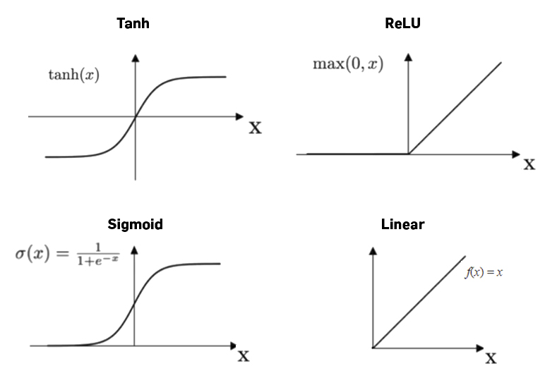
ACTIVATION FUNCTION
The function f is non-linear and is called the Activation Function. The purpose of the activation function is to introduce non-linearity into the output of a neuron.

Slide 15
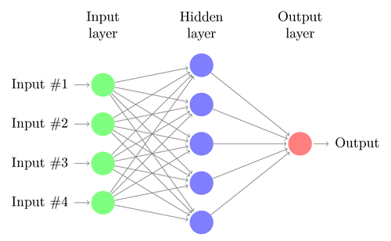
NETWORK LAYERS

Slide 16
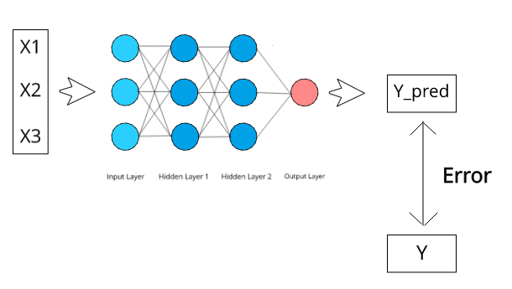
FEED FORWARD PROPAGATION

Slide 17
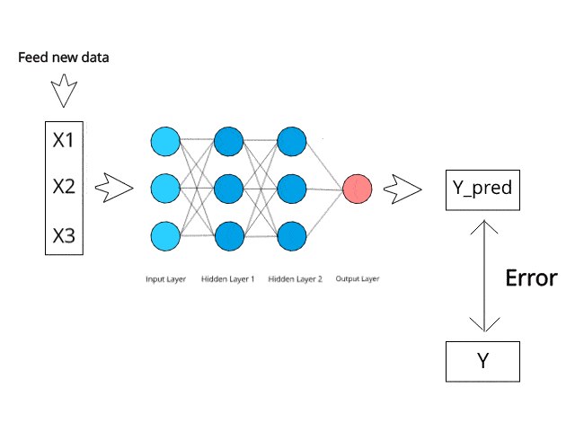
BACKWARD PROPAGATION

Slide 18
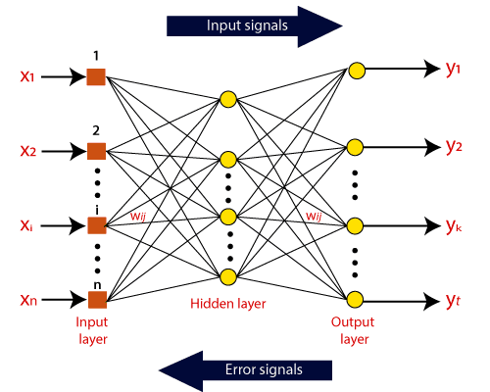
WORKING

Slide 19
PROBLEM STATEMENT
With today’s modern lifestyle, large populations of the world are getting diagnosed with heart diseases. Due to several underlying contributory risk factors such as diabetes, high blood pressure, high cholesterol, abnormal pulse rate and many other factors, hence, it makes heart disease prediction challenging. Various methods in data mining and neural networks have been implemented to explore the austerity of heart disease like Artificial Neural Network (ANN). In this model we are going to develop an efficient prediction model(system) for Heart Disease using neural networks.

Slide 20
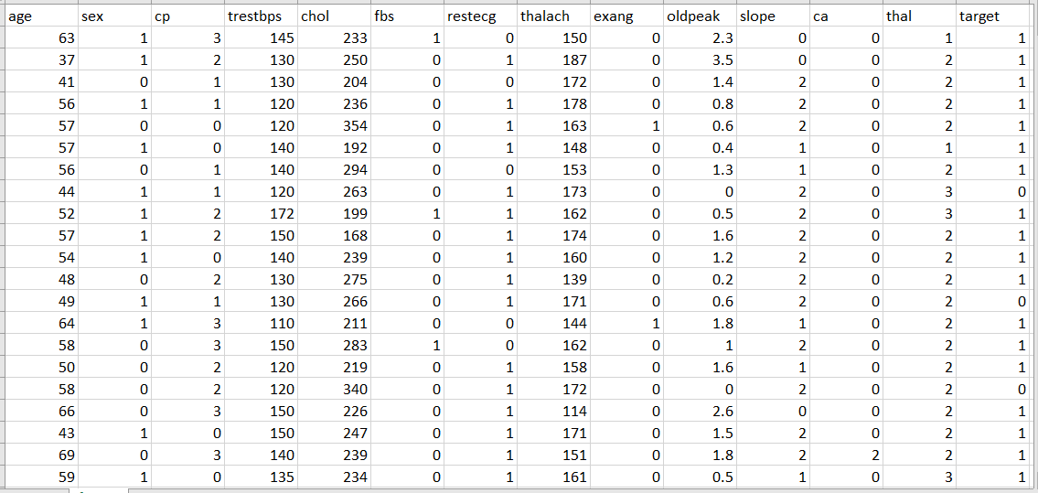
DATASET

Slide 21

Implementation of ANN in Python

Slide 22
Data Pre-Processing
# importing the libraries
import numpy as np
import pandas as pd
# importing the dataset
dataset = pd.read_csv('/content/heart.csv')
X = dataset.iloc[:,:-1].values
y = dataset.iloc[:,-1].values

Slide 23
Data Pre-processing
# Splitting the dataset into the Training set and Test set
from sklearn.model_selection import train_test_split
X_train, X_test, y_train, y_test = train_test_split(X, y, test_size = 0.2, random_state = 0)
# Feature Scaling
from sklearn.preprocessing import StandardScaler
sc = StandardScaler()
X_train = sc.fit_transform(X_train)
X_test = sc.transform(X_test)

Slide 24
Building The Model
# Importing the Keras libraries and packages
import keras
from keras.models import Sequential
from keras.layers import Dense
# Initialising the ANN
classifier = Sequential()
# Adding the input layer and the first hidden layer
classifier.add(Dense(units = 6, kernel_initializer = 'uniform', activation='relu', input_dim=13))
# Adding second hidden layer
classifier.add(Dense(units=6, kernel_initializer='uniform', activation='relu'))
# Adding the Output layer
classifier.add(Dense(units=1, kernel_initializer='uniform', activation='sigmoid'))

Slide 25
Training of the ANN
# Compiling the ANN (Configuring the learning process)
classifier.compile(optimizer = 'adam', loss = 'binary_crossentropy', metrics = ['accuracy'])
# Fitting the ANN to the Training set
classifier.fit(X_train, y_train, batch_size = 10, epochs=50)

Slide 26
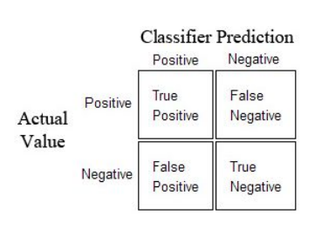
Making the prediction and evaluating the model
# Predicting the Test set results
y_pred = classifier.predict(X_test)
y_pred = (y_pred > 0.5)
# Making the Confusion Matrix
from sklearn.metrics import confusion_matrix
cm = confusion_matrix(y_test, y_pred)

Slide 27
THANK YOU

